Slide 1



Data Analyst
PORTOFOLIO
Dio Obriiel Saragih
Binus University

Slide 2

ABOUT ME
Hi! I’m Dio Obriel Saragih, an active student at Binus University, majoring in Computer Science with a focus on Database Management.
I am passionate about data analysis and skilled in using Power BI and Microsoft Excel to transform raw data into actionable insights.
Beyond technical skills, I am a good communicator and a collaborative team player. I’m eager to keep learning and growing, particularly in the areas of data analytics and business intelligence, with the goal of delivering value-driven solutions.

Slide 3


EDUCATION
SMA Yadika 8
Binus University
2020-2023
2023-now
Strengthened logical thinking and problem-solving through mathematics and science.
Building skills in database management, data analysis

Slide 4







MY SKILLS & TOOLS
Data Analysis & Visualization
Power BI (Dashboard Creation, Data Visualization, Forecasting)
Microsoft Excel (Pivot Tables, Charts, Data Cleaning)
Database & Programming
Basic SQL
Python (Cleaning up duplicate data and missing data)
Soft Skills
Strong communication skills
Team collaboration
Problem-solving & critical thinking

Slide 5


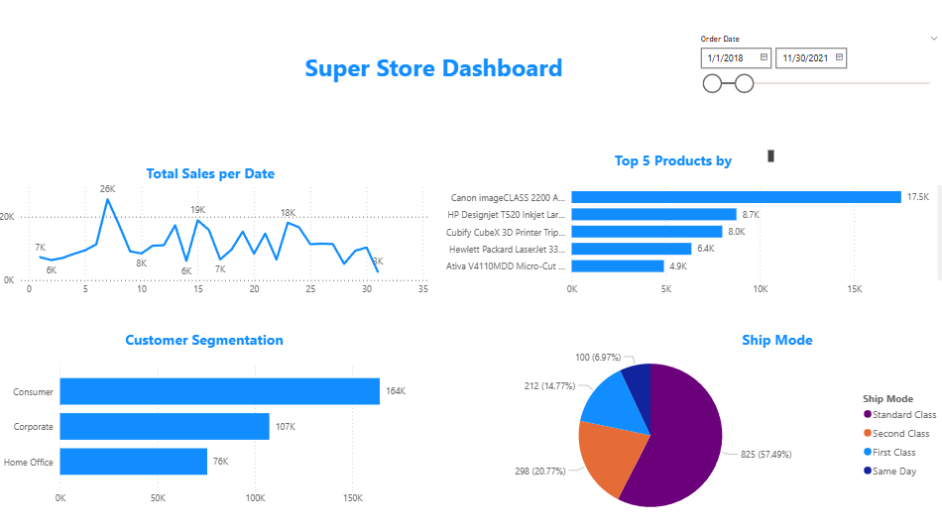

PROJECT PORTFOLIO POWER BI
1. Total Sales per Date
The line chart shows fluctuating daily sales with peaks around 26K, 19K, and 18K during the selected date range (January 2018 – November 2021).
2. Top 5 Products
Canon imageCLASS 2200 is the best-selling product with 17.5K sales, far ahead of other products.
The second-best product, HP Designjet T520, has 8.7K sales, showing that Canon contributes a significant share of total revenue.
3. Customer Segmentation
Consumers contribute the largest share (164K), followed by Corporate (107K) and Home Office (76K).
This means retail consumers are the primary target market, and marketing strategies should focus on them to maximize revenue.
4. Shipping Mode
Standard Class is the most used shipping mode (57.49%), followed by Second Class (20.77%) and First Class (14.77%).
Same Day delivery is the least used (6.97%), which might indicate either high cost or low demand for urgent shipping.
Key Insights
Focus on Consumers: Most sales come from the consumer segment, so campaigns targeting them will likely boost revenue.
Top Product Dominance: Canon imageCLASS is a key driver — ensuring stock availability is critical.
Shipping Strategy: Standard class dominates; promoting faster delivery options (same-day or first class) might unlock premium customers.

Slide 6
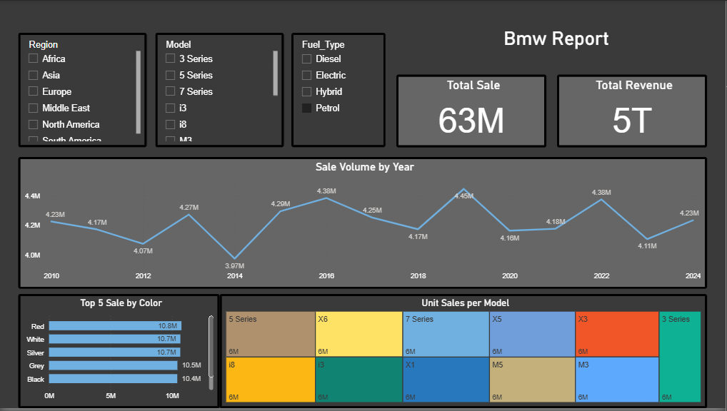
PROJECT PORTFOLIO POWER BI
Sales Trend
Between 2010 and 2024, BMW’s sales performance shows a fluctuating pattern.
Sales dropped to 3.87M units in 2014, then peaked at 4.45M units in 2019.
Although there were declines after 2019, sales bounced back in 2022, reaching 4.38M units.
This suggests BMW has maintained a stable market presence, averaging around 4M units sold per year.
2. Color Preferences
The top five best-selling BMW colors are:
Red: 10.8M units
White: 10.7M units
Silver: 10.7M units
Gray: 10.5M units
Black: 10.4M units
Bright colors such as red and white are slightly more popular compared to darker tones.
3. Best-Selling Models
Several BMW models consistently contribute high sales volumes, including:
3 Series, 5 Series, 7 Series
X3, X5, X1
M3, M5, i3, i8
Each of these models recorded around 6M units sold, indicating BMW’s balanced product with no single model overwhelmingly dominant.
4. BMW achieved a total sales volume of 63 million units and generated approximately USD 5 trillion in revenue.
This highlights BMW’s strong global market presence and ability to appeal across regions, customer preferences, and product categories.

Slide 7
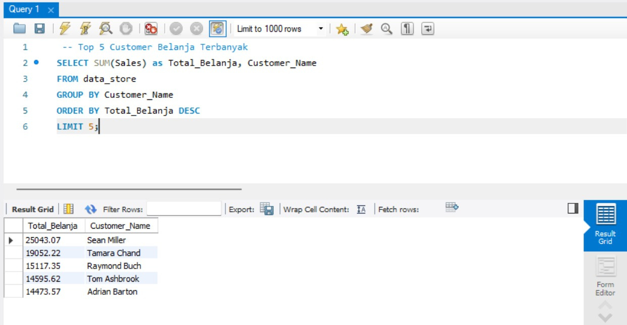
PROJECT PORTFOLIO SQL
Key Insights
Sean Miller is the top customer with total purchases of 25,043.07. He is the company's most valuable asset in terms of revenue generated.
There is a significant gap between 1st place (Sean Miller) and 2nd place (Tamara Chand). The difference is approximately 5,990, which shows that Sean Miller is in a league of his own compared to other customers on this list.
Customers ranked 2nd to 5th (Tamara Chand, Raymond Buch, Tom Ashbrook, and Adrian Barton) form the second “heavyweight” customer group. Their total spending ranges from 14,400 to 19,000.
Although not as high as Sean Miller, this group collectively contributes a very large and very important amount of revenue to the business.

Slide 8
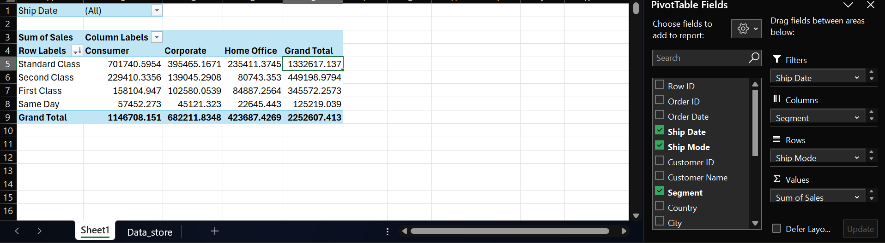
PROJECT PORTFOLIO PIVOT
Key Insights
Highest Sales Based on Shipping Mode
When looking at total sales for each shipping mode, Standard Class shows the highest sales figure, amounting to $1,332,617,137.
Conversely, Same Day shipping has the lowest total sales, amounting to $125,219,039.
Highest Sales by Customer Segment
Of the three customer segments, the Consumer segment contributes the most to sales, with a total of $1,146,708,151.
The Home Office segment recorded the smallest sales contribution, amounting to $423,687,4269.
Most Significant Combination
The largest sales specifically came from the combination of the Consumer segment using the Standard Class shipping mode. The total sales from this combination alone reached $701,740,5954.

Slide 9







LETS WORK TOGETHER
081381785863
dioobriel205@gmail.com
linked-in

Slide 10




Closing
THANK YOU

